Slide 1
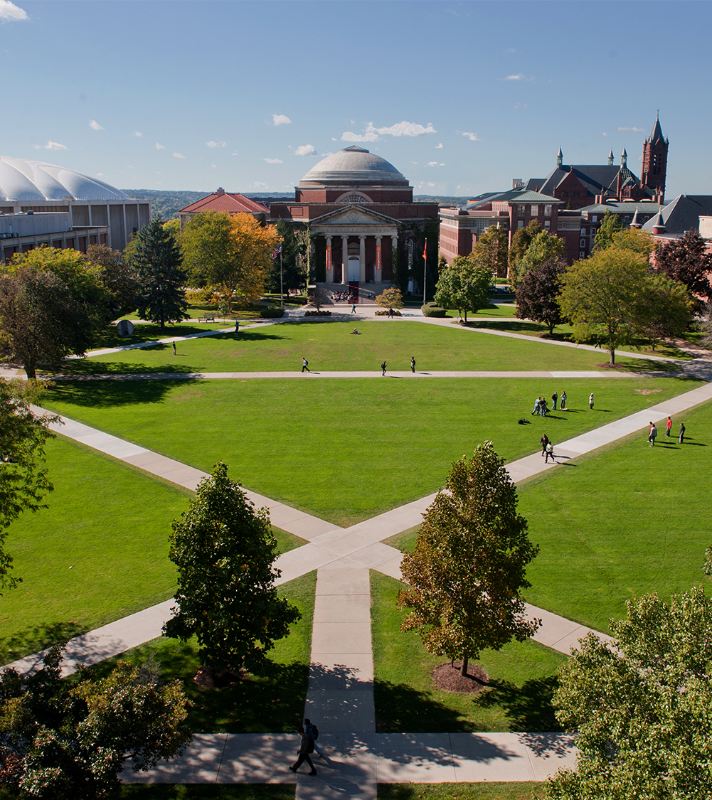
CPU Temperature as a Device Biometric
Department of Electrical Engineering and Computer Science
Evan Smith
9/15/2021

Slide 2
Overview
Goal: Use CPU temperature to classify devices
MVP
Classify by device chipset
Authentication possible
Stretch
Classify by device
Identification possible
Tasks
Gather data
Develop classifier
Assess viability
Department of Electrical Engineering and Computer Science

Slide 3
Background
Some potential use cases
IoT verification
Dual-factor authentication
Current identifiers
IP Address – trivial to spoof
MAC Address – “snoofable”, drivers available
IMEI – possible to alter via flashing
Department of Electrical Engineering and Computer Science

Slide 4
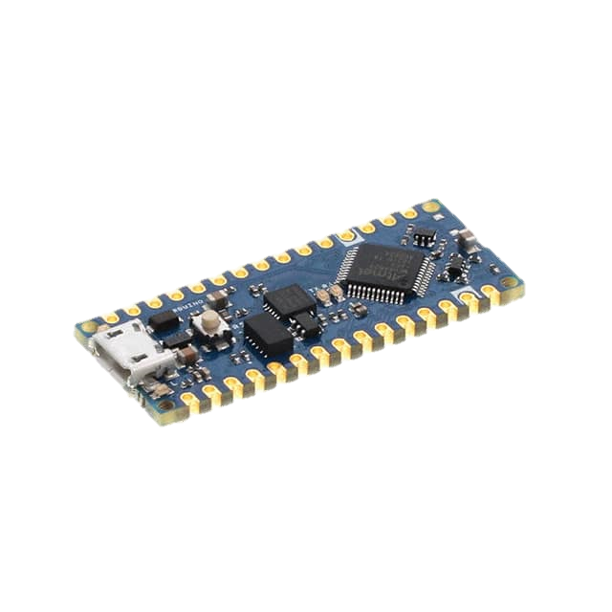
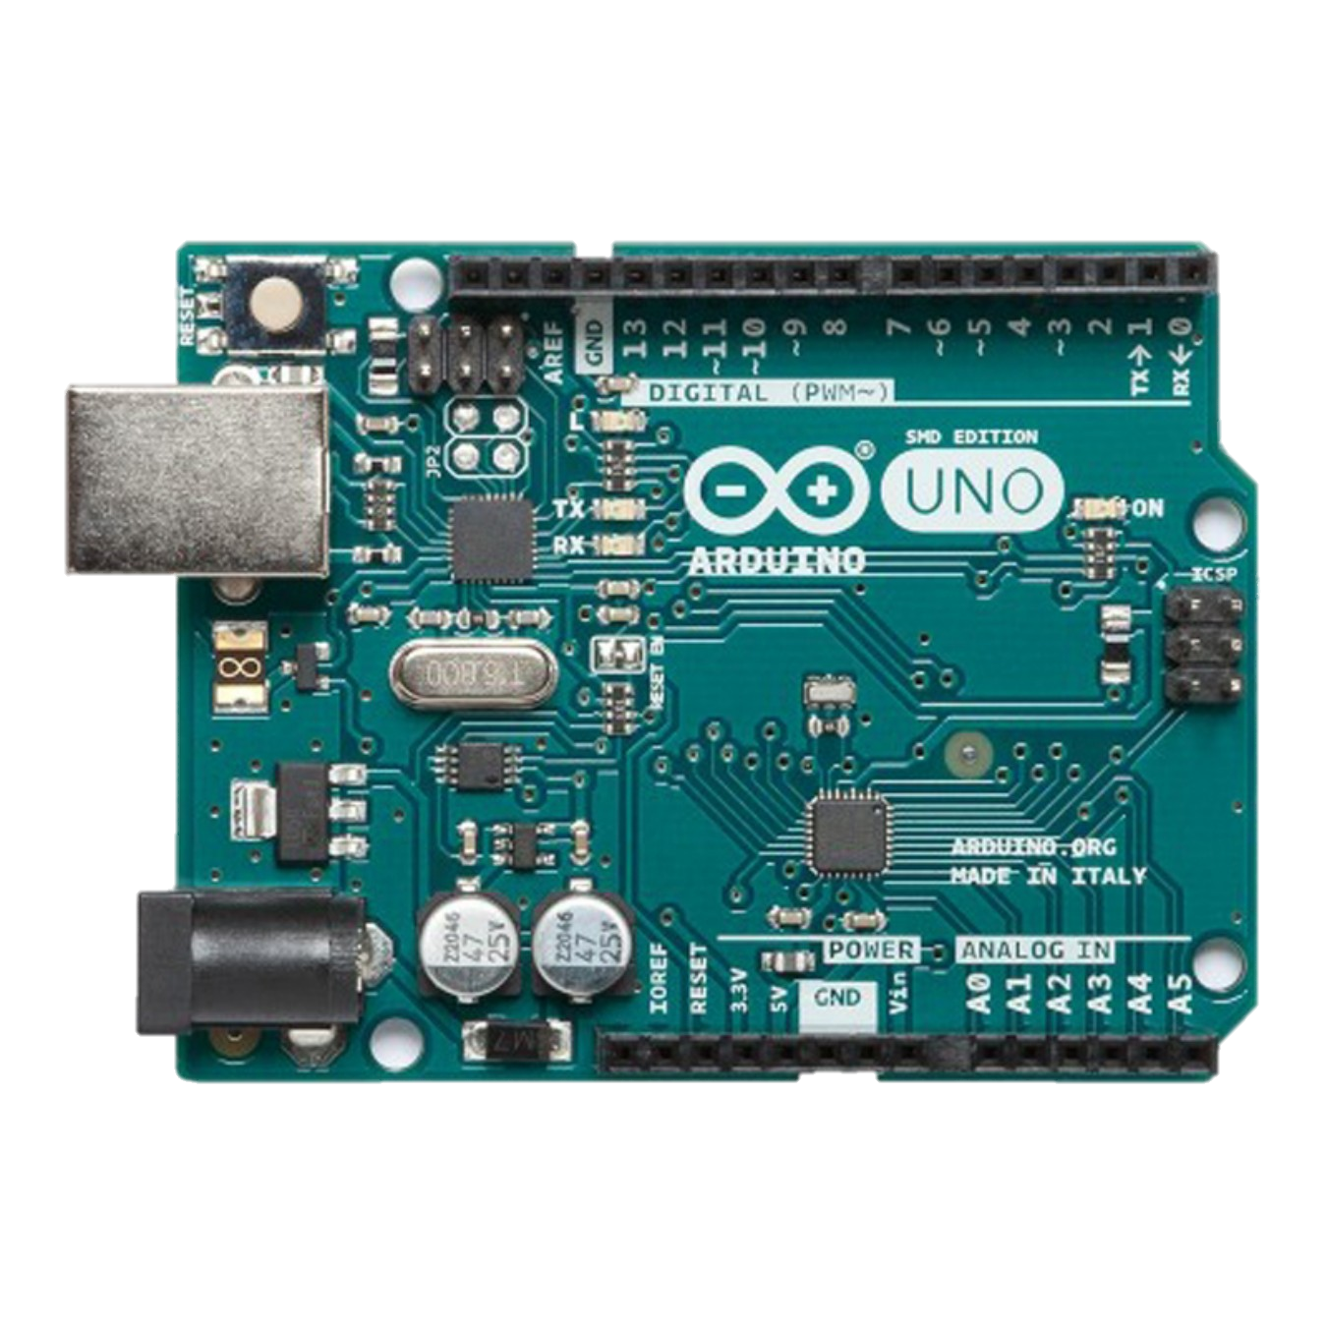
Experiment Design - Devices
Arduino Every (ATMega4809)
Arduino Uno (ATMega328P)
https://www.digikey.com/en/products/detail/arduino---bcmi-us-llc/ABX00028/10239971
https://www.robotshop.com/en/arduino-uno-rev3-smd.html?
Department of Electrical Engineering and Computer Science

Slide 5
Data Gathering Process
Wrote C++ CPU soaking program
Recorded 30 time series per device
100 data points/series
Compiled labelled data
Normalized on initial temperature
Imported data to Jupyter Notebook
Department of Electrical Engineering and Computer Science

Slide 6
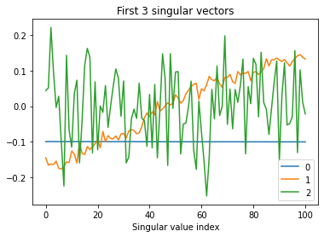
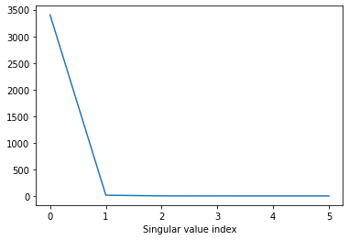
Proving SVD Viability
Singular Value Decomposition (SVD)
Extracts patterns from data and its relative importance
Department of Electrical Engineering and Computer Science

Slide 7
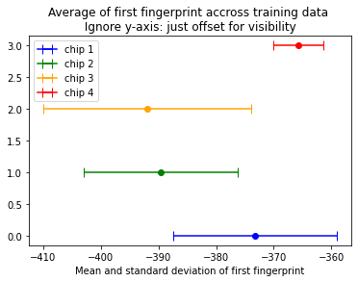
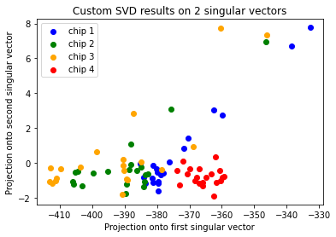
Generating an Effective Classifier
Graph “fingerprints” of training data
Inner product of training data and the first singular value vectors
Department of Electrical Engineering and Computer Science

Slide 8
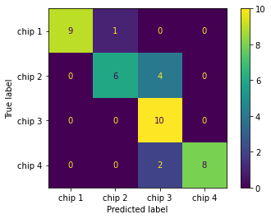
Quantifying The Classifier’s Success
Model training fingerprints as a gaussian
Calculate each test fingerprint’s most likely device distribution
Overall accuracy: 85%
Device ID | Classification Accuracy
 | 2 Singular Values | 3 Singular Values
1 | 90% | 90%
2 | 10% | 60%
3 | 100% | 100%
4 | 80% | 80%
Overall | 70% | 85%
Department of Electrical Engineering and Computer Science

Slide 9
Conclusion – Device Biometrics Are Viable!
High accuracy of classifier promising
Especially given data collection issues with hardware
Multithreading
Device application and form factor
Both authentication and identification possible
Can achieve higher TP or lower FN depending on use case
Department of Electrical Engineering and Computer Science

Slide 10
Future Work
Improving CPU soak program
Task-based architecture
Variable load parameter
Exploring additional biometrics
Processing time
Network card speed
Mimicking Viola-Jones pattern for higher granularity
Department of Electrical Engineering and Computer Science

